Slide 1
INTEGRATED
MARKETING
COMMUNICATIONS
Advertising can help reduce "Obesity".

Slide 2
Integration and coordination of communication channels
The purpose is to provide consistent message with clarity (Finne and Grönroos 2017)
INTRODUCTION
Purpose is to present the stand in favor of advertising projecting potential for reducing obesity
With the focus on socially responsible advertisements, obesity can be reduced
Finne, Å. and Grönroos, C., 2017. Communication-in-use: customer-integrated marketing communication. European Journal of Marketing, 51(3), pp.445-463.
Notes:
The term integrated marketing communication refers to the efforts of all the organizations in integrating all the brand promotion methods and promote their respective products and services to a targeted segment. It enables all the marketing mix aspects in order to create harmony in promoting the products and the services to the end users. The purpose of the presentation is to present a stand in favour of the positive role of advertisements in reducing obesity concerns.

Slide 3
TOOLS OF INTEGRATED MARKETING COMMUNICATIONS
Advertising
Sales Promotion
Personal
Selling
Public
Relations
Direct Marketing
Events & Experiences
Social Media Marketing
Camilleri, M.A., 2018. Integrated marketing communications. In Travel marketing, tourism economics and the airline product (pp. 85-103). Springer, Cham.
Notes:
Integrated Marketing Communication is facilitated by enabling the tools or channels that helps in projecting message to the target audience. The tools of IMC involves Advertising, Sales Promotion, Personal Selling, Public Relations, Direct Marketing, Events and Experiences and Social Media Marketing (Camilleri 2018).
All these tools can be effectively used to promote awareness on obesity. Advertising is the main theme for this presentation and details is given in the following slides. We can use the other techniques for rising awareness on obesity as well.
If we can increase the sales promotion of healthy foods and fitness equipments then it will reduce obesity.
If we can organize corporate and social events and invite eminent persons and discuss about obesity issues, it will increase awareness.
If we post different info graphics, animations, audio and visuals on Facebook, Twitter and Instagram, it will be very effective as well.

Slide 4
ADVERTISING
Paid form of communication
Non-personal promotion on obesity
Identified sponsor will help in better reach
Different media used to spread information, awareness or message (Hackley and Hackley 2017).
Examples of media used - Print, Network, Electronic and Display.
Hackley, C. and Hackley, R.A., 2017. Advertising and promotion. Sage.
Notes:
Advertising is a simple market tactic that involves paying and promoting products and services to a larger group of audience. The main purpose of advertisements is to reach people who are willing to pay and enticing to buy the organization’s products and services.
There are different media that can be used for advertisements and they are newspapers, satellites, wireless, telephones, magazines, radio, television, web page, audio, billboards, video tape, signs and posters.
We can utilise this channel in order to reach a huge customer base at a small time and highlight about the increasing obesity issues. Newspaper can highlight various obesity cases, web pages can show feedback from various doctors and health service providers, posters, signs and billboards on increasing obesity can be used to engage people on the move.

Slide 5
ADVANTAGES OF ADVERTISING
It can increase awareness.
It can communicate information.
The facts and figures about obesity can be spread to a large number of audience in a small time.
Reveals the truth.
Attracts customer attention(Fowler, Franz and Ridout 2020)
Fowler, E.F., Franz, M.M. and Ridout, T.N., 2020. The Blue Wave: Assessing Political Advertising Trends and Democratic Advantages in 2018. PS: Political Science & Politics, 53(1), pp.57-63.
Notes:
Advertising helps in –
It spreads awareness amongst people about the rising concern of obesity.
It helps in communicating all the details facts, figures and information to the audience.
The most important part is that advertisement on obesity is an advertisement on a health issue and thus it tries to focus on revealing all the minute truths that are hidden in general by all the foods and beverage companies.
Advertisement can help reaching a number of people in just a blink of an eye if the proper channel is used. Thus advertisements on obesity can also help people in understanding the underlying health issues attached with obesity.

Slide 6
TACTICS OF ADVERTISING ON OBESITY
Utilization of Influencers
Thinking beyond the screen
Grabbing attention quickly
Taking advantage of personalization (De Pauw et al. 2018)
Stop bombarding on social media
Avoid participation in disruption
De Pauw, P., De Wolf, R., Hudders, L. and Cauberghe, V., 2018. From persuasive messages to tactics: Exploring children’s knowledge and judgement of new advertising formats. New Media & Society, 20(7), pp.2604-2628.
Notes:
Consumers does not like to get interrupted or feel disturbed and hence participation in disruption should be avoided. The advertisement on obesity must be sent or directed towards the consumers at one time. It must not be sent through emails or messages at regular intervals.
The Guerrilla marketing should be kept in mind. Advertisements should not be any typical one like those in the toilets and pavements but it should be eventful, colourful and have stunts to grab consumer attention. If proper message and content on obesity can be provided in the advertisement it can create a huge impact.
28% of the words written in any article are actually read by the consumers. 72% is ignored. So the messages must be kept short and the words should be clear and counted. A short clip on ill effects, or what can happen because of being over-weight or any facts hidden from the consumers can be shown and a question can be raised at the last to engage the audience.
Using of brand ambassadors helps in influencing the minds of the consumers. If any eminent person can come and provide with his/her real life example on how they work out and how they maintain their weight in order to avoid obesity, it can be effective.

Slide 7
Advertising creates awareness about various information on obesity, its negative impacts and the preventive measures as well
It understands the need of the customers and focus on that need area
It creates social awareness by providing various information that customers were unaware about
HOW ADVERTISING ON OBESITY CAN ADD VALUE
It engages with the customers with attractive visuals and arouses demand in the mind of consumers
Globalwebindex.com 2020. AdAge, Top Global Consumer Trends In 2020 – Globalwebindex. [online] Globalwebindex.com. Available at: <https://www.globalwebindex.com/reports/trends2020?utm_campaign=Reports&utm_source=ppc&utm_medium=google&utm_term=google-search-trends-2020&utm_content=google-search-trends2020&utm_source=ppc&utm_medium=ppc&utm_term=%2Bmarketing%20%2B2020&utm_campaign=GWI++UK++EN++Trends+2018++Marketing+Trends++BMM&hsa_cam=8263301435&hsa_mt=b&hsa_ver=3&hsa_src=g&hsa_ad=399661220556&hsa_net=adwords&hsa_tgt=kwd449550397570&hsa_acc=9903771596&hsa_grp=86792915004&hsa_kw=%2Bmarketing%20%2B2020&gclid=Cj0KCQjwjoH0BRD6ARIsAEWO9DuWojXCcd9Ayy7moNaAFE53f7NlSpHtnDt3njrbhCeNsjYVjEOq1iIaAgteEALw_wcB> [Accessed 29 March 2020].
Notes:
Advertisement helps in communicating effectively.
It helps in improving the brands by transferring the message out to the world. It tells the customers what is being done and why it is done that adds a value to the brand. If a health institution provides advertisement about the ill effects of the obesity, it will create a good impression about the institution and at the same time the advertisement will be taken seriously by the viewers.
It creates awareness by telling stories. If various health stories, the condition that occurred because of not following the over-weight guidelines can be mentioned and shown. If stories on how it has lead to the end of a life and how it can be prevented be shown to audiences, it will create a long lasting impact.
If we keep a question in the end like –”Which way you choose to Live?” after showing the negative impacts, it will make better engagement.
Unified measurement. Proper data and consistent data must be provided in related advertisements to assure the people about the facts (Globalwebindex.com 2020)

Slide 8
Powerful music, images, and contents can evoked feelings and sympathy in the minds of the consumers
ADVERTISING AND SOCIAL AWARENESS
Social awareness advertisements help in promoting societal changes (De Vries, Gensler and Leeflang 2017)
Several campaigns like Anti-Smoking Campaign, Animal Cruelty Prevention, Traffic Safety, Poverty and Child Abuse have already taken place.
De Vries, L., Gensler, S. and Leeflang, P.S., 2017. Effects of traditional advertising and social messages on brand-building metrics and customer acquisition. Journal of Marketing, 81(5), pp.1-15.
Notes:
Advertisements can also be used for social awareness. The social issues like food habits, obesity and its ill effects can be highlighted through pictures and videos. A proper audio – visual will help in raising questions in the mind of the consumers. The consumers will always try to find a solution and thereafter try to take the necessary actions after seeing the advertisements. This will enable solving various social issues thereafter bringing a societal change. The more creative videos, the more will be the engagement of the target audiences. Sharing such videos on social media platforms will also help enabling awareness among a large number of consumers in a small time.

Slide 9
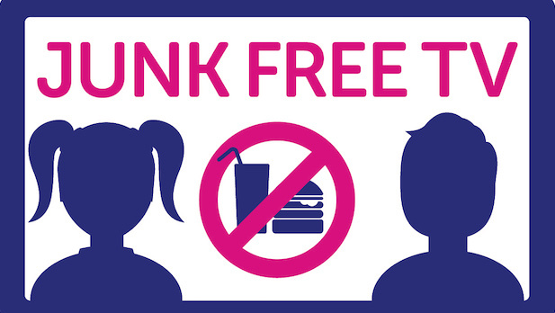
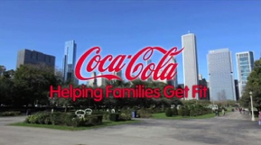
REAL LIFE EXAMPLES OF SOCAL ADVERTISEMENTS
PREVENTING JUNK FREE TV CAMPAIGN FOR DISCOURAGING THE PROJECTION OF JUNK AS A GOOD OPTION
THIS AD DEPICTS THE INITIATIVE OF COCA-COLA FOUNDATION IN HELPING THE WELL-BEING OF INDIVDIUALS FIGHTING THROUGH THE STATE OF OBESITY
Notes:
These advertisements are instances of socially responsible advertising campaigns that helps in positively influencing the state of well-being amongst community members. Advertisements can play a major role in influencing the behavior and practices of children and adults.

Slide 10
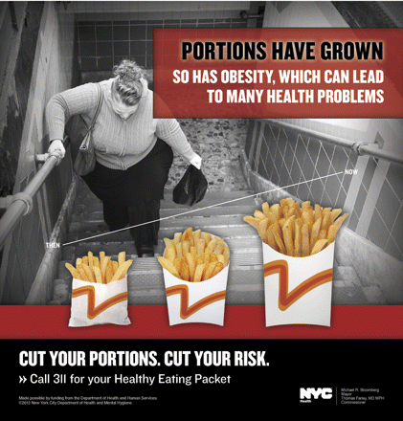
REAL LIFE EXAMPLES OF SOCAL ADVERTISEMENTS
AD CAMPAIGN BY NEW YORK CITY DEPARTMENT OF HEALTH AND MENTAL HYGIENE
Notes:
This is another instance of socially responsible ads, which is projected at the concern of increasing obesity.

Slide 11
DIDN'T IT EVOKE SOMETHING IN YOU
Notes:
It did right?
These advertisements make us think that we must step up for the change.
It creates a feeling of sympathy and makes us feel sad at the same time. And hence we step forward for a good cause.
If these advertisements can create a sense of sympathy and a feeling of guilty and sadness in you, then think what effect can an advertisement relating to health issues can have in our minds.

Slide 12
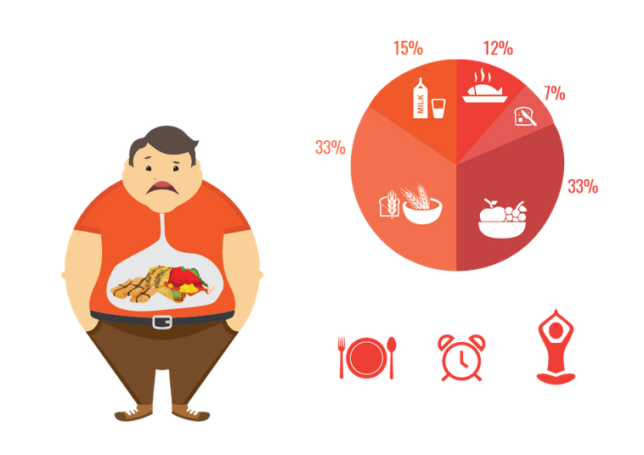
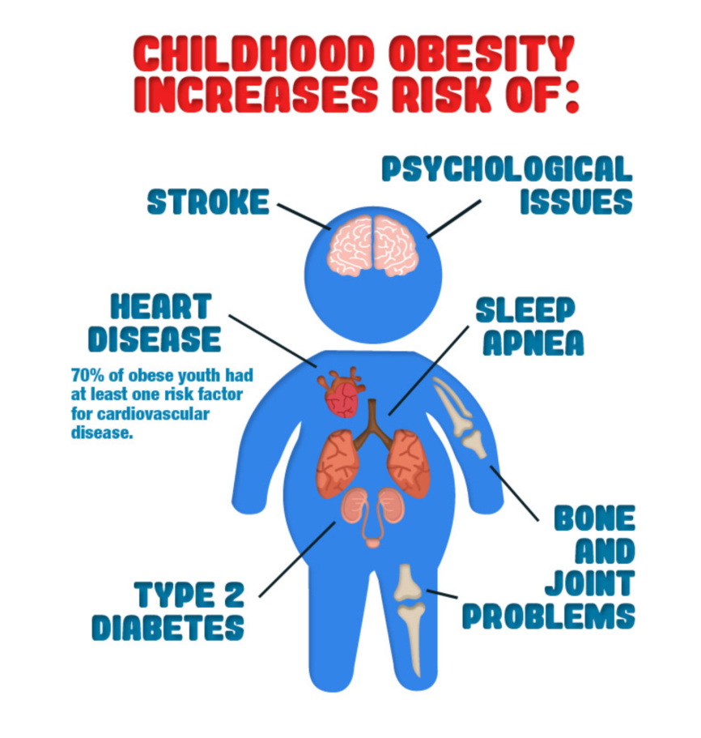
What are the below pictures telling us about obesity?
OBESITY
Alpert, M.A., Omran, J. and Bostick, B.P., 2016. Effects of obesity on cardiovascular hemodynamics, cardiac morphology, and ventricular function. Current obesity reports, 5(4), pp.424-434.
Notes:
Obesity is a major health concern globally.
The above pictures depict clearly that obesity or overweight is caused because of –
Physical Inactivity
Genetics
Over eating and frequency of eating
Type of diet
Consumption of more carbohydrates
Medications
Hypothyroidism insulin resistance and other diseases.
Social issues like lack of money to purchase proper diet, lack of place to exercise and walk.
Health issues associated with obesity are –
High blood pressure
Hypertension (Alpert, Omran and Bostick 2016)
Stroke
Heart Attack
Type 2 diabetes
High Cholesterol
Bone and Joint problems
Psychological Issues

Slide 13
OBESITY WORLDWIDE
60% of men and 50% of women worldwide are overweight.
Men - 69409
Women - 98750
Countries - 63
Basic health problems are related to obesity.
The number cases for young children increased from 32 million globally in 1990 to 41 million in 2016 (WHO.int 2020).
WHO.int 2020. Obesity And Overweight. [online] Who.int. Available at: <https://www.who.int/news-room/fact-sheets/detail/obesity-and-overweight>
Notes:
According to the World Health Organization, the obesity worldwide has increased three times since the year 1975.
39% of adults were overweight in 2016 and 13% obese.
More that 1.9billion adults were overweight in 2016 and over 650 million were obese.
Obesity can be prevented.

Slide 14
ADVERTISEMENT AND OBESITY
Research suggests that advertising and obesity are highly inter-related.
It states that advertising on junk foods influence the people’s mind and thereafter people start consuming the food and hence obesity increases (Wang, Liaukonyte and Kaiser 2018) .
However, concerns over obesity has grown and although the people were mislead they have started acting upon in spite of those attractive advertisements..
Wang, R., Liaukonyte, J. and Kaiser, H.M., 2018. Does Advertising Content Matter? Impacts of Healthy Eating and Anti-Obesity Advertising on Willingness to Pay by Consumer Body Mass Index. Agricultural and Resource Economics Review, 47(1), pp.1-31.
Notes:
Any form of foods and beverages marketing and advertisements influences the minds of the consumers. They influences the food preferences of the people and the consumption patterns. Most of the food products that are marketed or advertised contains a significant amount of sugar, fat and cholesterol that increases the obesity risk.

Slide 15
HOW ADVERTISING IS INFLUENCING CHILDREN?
https://www.youtube.com/watch?v=oxlmrcr-2Bo
Notes:
The advertisement of the toffees and other food products have showed the children about the taste and the enjoyment. The advertisement only talks about the sweet taste and the beautiful sensation that will happen while consuming those foods but these advertisements hide the calorie fact and the effect on the health, because of which the children are misguided.
We don’t realize the effect these advertisements have on us. There are many advertisement that promoted continued acceptability of smoking and encouraged in a false belief that most people smoke. Focus of the fast foods are on family, fun and appealing foods. But there remains a difference in how life is presented and how that product is sold. Advertisements on beer and liquor makes false promises about carefree life and good time but they don’t show what happens next.

Slide 16
YES
IT
CAN
CAN ADVERTISING HELP REDUCE OBESITY ?
Notes:
So the fact is that we get influenced by advertisements that basically fools us. If that is the case then if social awareness and proper advertisements on the negative sides are focused on any advertisements or social media, then the people can also be influenced about that as well.
If we can show the negativity of the advertisement of the food and beverages companies through a social awareness advertisement, people will believe that. We need to produce evidences to the people by showing the original advertisement on the food and beverage and thereafter show what is being hidden, then people can relate and they can be aware. The following video is an example of the same.

Slide 17
https://www.youtube.com/watch?v=sG9Jo3plhPA
Notes:
The advertisement tells about the facts that Starbucks hide from us and if these issues are highlighted like this advertisement has done, people will become more aware and try to avoid from consuming such things on a regular basis.

Slide 18
WE NEED TO RAISE AWARENESS
https://www.youtube.com/watch?v=xUmp67YDlHY
Notes:
The advertisement clearly explains what is happening with the passage of time and in the end states when it should be stopped.

Slide 19
HOW IS THAT AD HELPING?
It starts with a critical situation
Shows the fooding habits
Shows what the doctor is saying
Shows the parenting issue
Rest the choice upon the viewers
Notes:
The advertisement starts with a boy being taken to the hospital and then the video is rewinded to what caused the situation. It can be seen that the situation occurred because of improper physical activities and food habits. The video ends with making an impression on the minds of the audience so that we can take step from now onwards without any delay.

Slide 20
WE NEED TO RAISE CONCERN AS WELL
https://www.youtube.com/watch?v=7DnC0zD51I4
Notes:
The advertisement tells that we are eating our heart out if you consume improper foods. Thus it highlights on the fact that it can cause serious heart issue and ultimately death.

Slide 21
DOES IT HAVE A LONG TERM IMPACT?
YES.
HOW?
LET US SEE THE NEXT VIDEO AND THEN EXPLAIN.

Slide 22
https://www.youtube.com/watch?v=upi0EKiKtq8
Notes:
The advertisement provides with information on health.
It shows the concern of the child about her parents.
It shows that she is afraid to loose her parents.
This advertisement creates awareness in the mind of the parents about their future as well as the child's future.
If this advertisement can be used in Social Media Sites as well, the response will be powerful.

Slide 23
Target Audience
Proper Channel
Consistent Look
Clear Message
Online Campaigns
HOW TO CREATE MORE VALUE
Notes:
The audiences can be targeted in two ways –
Focusing on the health concerned people.
Focusing on the people who are working regularly and does not have enough time to have healthy food and primarily depends on beverages and fast foods.
Web Analytics is a great tool in today’s world that helps in determining the consumer needs and preferences. The advertising agencies can make use of this technique and thereafter target the consumers specifically according to their health habits.
The advertisements must have clear messages, it mus be precise and must maintain its quality of attractiveness and presentation.

Slide 24
ANOTHER EXAMPLE
https://www.youtube.com/watch?v=9dL4lN6GKi4
Notes:
This advertisement clearly shows the casualness of the man walking. He did not take the proper steps at the beginning and hence ended up being overweight and looking more aged in the end. This creates an awareness in the minds of the consumer that they need to take step at the very beginning only. The advertisement shows clear interaction with the audience as well in order to reflect what they are doing is wrong and steps should be taken at the right time.

Slide 25
DID THESE ADVERTISEMENT MADE ANY IMPACT?
YES.
AAFP.org 2020. AAFP [online] Available at: https://www.aafp.org/news/obesity/20100517fed-initiatives.htmlhttps://www.aafp.org/news/obesity/20100517fed-initiatives.html
Janice Ponce de Leon, S., 2020. Children Step Up To Obesity Challenge In Dubai. [online] Gulfnews.com. Available at: <https://gulfnews.com/uae/health/children-step-up-to-obesity-challenge-in-dubai-1.1493963> [Accessed 29 March 2020].
Halpern, D., 2020. Victoria, Australia, Steps Up To The Obesity Challenge. [online] Bi.team. Available at: <https://www.bi.team/blogs/victoria-australia-steps-up-to-the-obesity-challenge/> [Accessed 29 March 2020].
Notes:
These advertisements create a choice in the minds of the consumers. It does not tell what to do and what not to do. Rather it rests the decision on the minds of the consumers. This interaction actually makes the audience think and decide. It has been seen in most of the cases that the audiences response positively to these advertisements.
500 children participated in the symbolic 2021 steps walkathon at the Dubai Mall (Janice Ponce de Leon 2020).
In Australia 66% of the people are now using stairs every day (Halpern 2020).
The UAE Cabinet has decided to increase the tax rates on sweetened beverages and other food products that leads to obesity.
The US Government has also taken up roles in combating obesity and supports the social awareness advertisements and campaigns (AAFP.org 2020).
The people globally have become health conscious and programs on preventing the junk foods and beverages are taking place globally.

Slide 26
EXAMPLE
https://www.youtube.com/watch?v=bHhCP5ad-zM
Notes:
Campaigns against Coca-Cola has made the company rethink business. The company has to face a number of questions as well as a number of challenges. It now has been forced to reshape its strategies so that it tastes good for the consumers but at the same time is not harmful for health. People across the world has become health conscious and have changed the consumption pattern because of which the company had to change its way of business.

Slide 27
LINKS
https://www.youtube.com/watch?v=oxlmrcr-2Bo – Slide 15
https://www.youtube.com/watch?v=sG9Jo3plhPA – Slide 17
https://www.youtube.com/watch?v=xUmp67YDlHY – Slide 18
https://www.youtube.com/watch?v=7DnC0zD51I4 – Slide 20
https://www.youtube.com/watch?v=upi0EKiKtq8 – Slide 22
https://www.youtube.com/watch?v=9dL4lN6GKi4 – Slide 24
https://www.youtube.com/watch?v=bHhCP5ad-zM – Slide 26

